Slide 1
How To Spot The Naughty From The Nice W.C. Claimant:
Three Case Studies
By: Michael J. Bertsch
Nicola, Gudbranson & Cooper, LLC

Slide 2
Telltale Troublesome Claimants

Slide 3
Exceptions = Trouble
* New Hire Claimant
* Problem Employee / Multiple Claimant
* No or Late Reporting of Incident
* No Witnesses When There Should Be
*Lawyer – Early On
*Recent Discipline

Slide 4
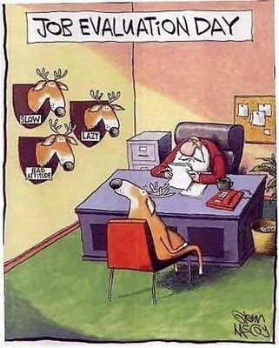

Slide 5
Profile Number 1: Teresa
56 year old female
Retail sales associate
Alleged incident on 6/1/16
Alleged injury – knee strain
Trip and fall
1st medical visit 5 days post incident
Late reported by phone
No incident report
No witnesses
History of absenteeism
Medical records with same symptoms
Facebook friends

Slide 6


Slide 7
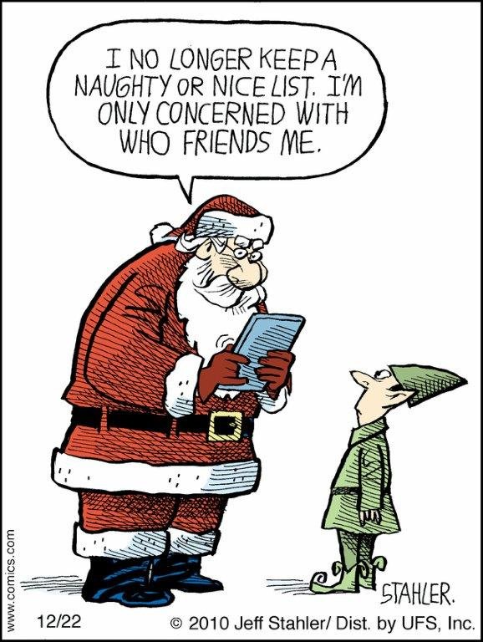

Slide 8


Slide 9
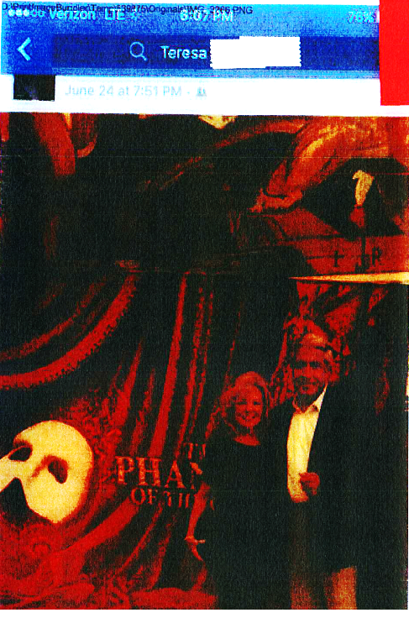

Slide 10


Slide 11
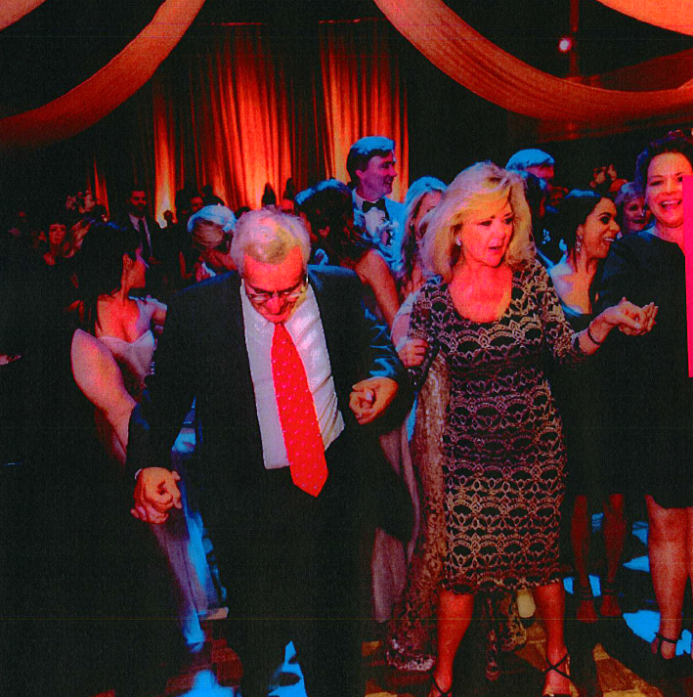

Slide 12
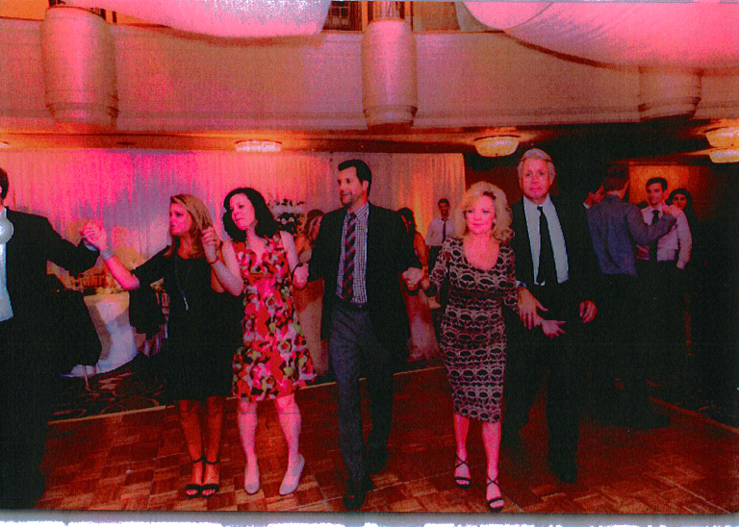

Slide 13
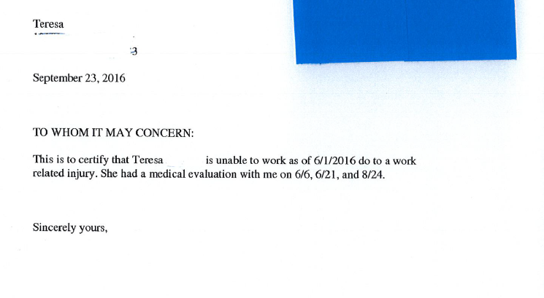

Slide 14
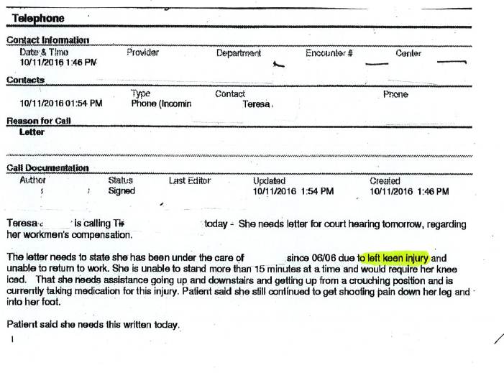

Slide 15
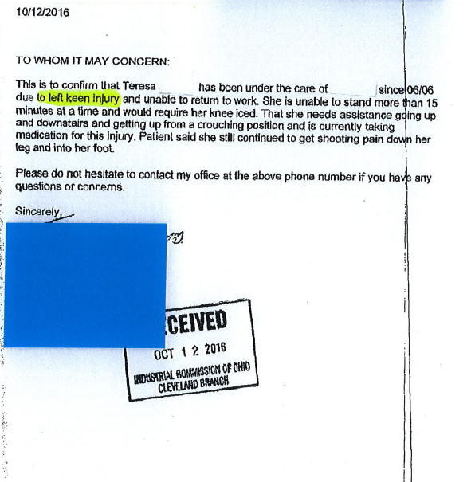

Slide 16
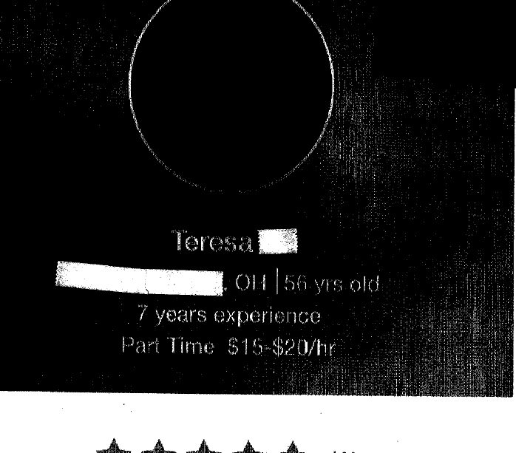
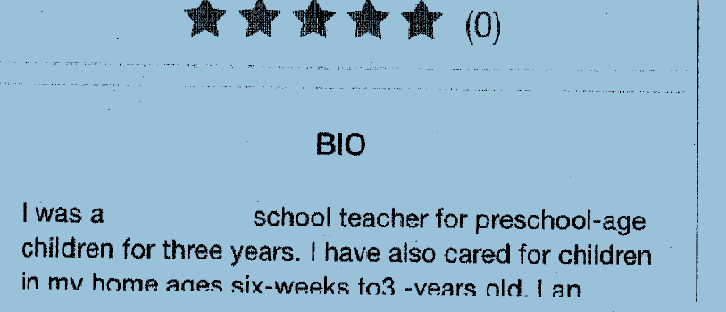

Slide 17
Profile Number 2: Daniel
41 year old male
1 month employee
Tow truck driver
Injured 11/27/15 while working
Allowed claim for lumbar strain
Off work 2 weeks: then radiating leg pain
PCP requests MRI
Motion for L4-5, L5-S1 Disc
PCP refuses to turn over pre-incident records

Slide 18
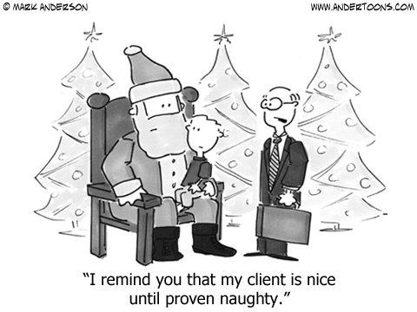

Slide 19
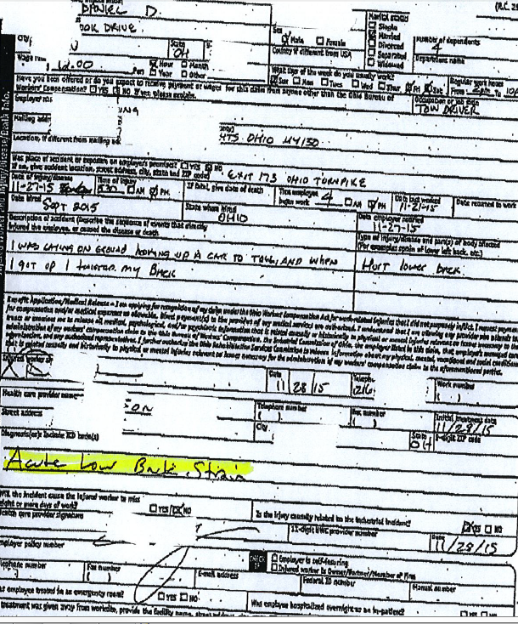

Slide 20
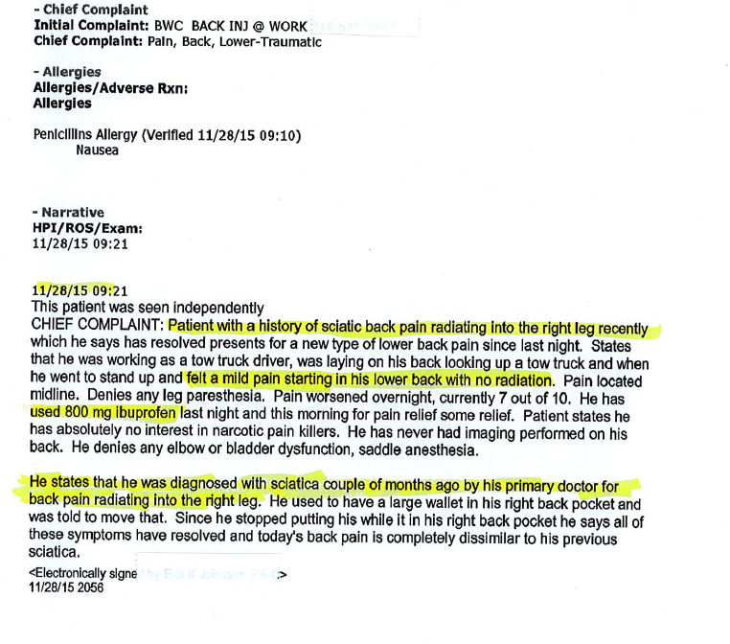

Slide 21
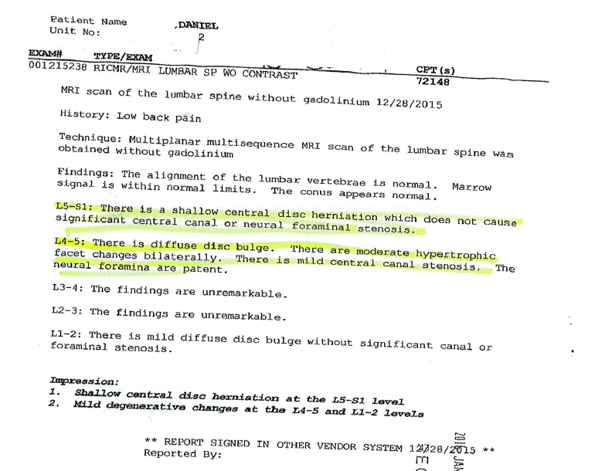

Slide 22
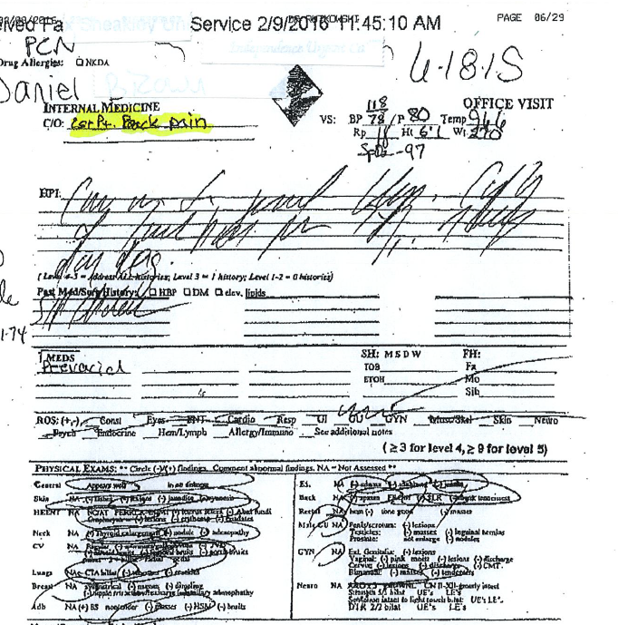

Slide 23
Profile Number 3: Dorothy
60 something female
Environmental service housekeeper
Injured in elevator fall
Allowed for fracture of right 4th and 5th finger
Surgery
Off work and paid benefits for 18 months - MMI
Retired
SSD
Lawyer referred Dorothy to psychologist; diagnosed with depression
“Cannot use right hand”

Slide 24
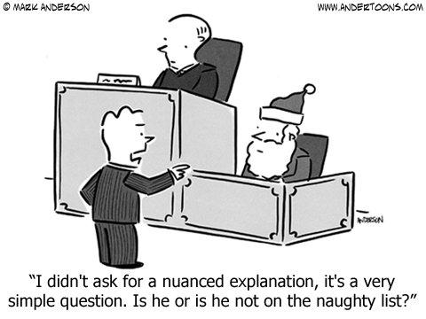

Slide 25


NAUGHTY CLAIMANT CHECKLIST
Delegate vs. Abdicate
Investigate Facts/Medical
IME (?)
Surveillance(?)
Extra ICO Hearing Time

Slide 26


Slide 27


Slide 28
THE END

